Slide 1

Marketing Strategy of Travel Assured
14 August 2022

Slide 2
Introduction
(1) Overview of Business
Travel Assured (the “Company”) is a travel insurance company.
In recent years, the Company’s business has been impacted by the Covid-19 pandemic.
(2) Business Need
The Company’s marketing budget has been reduced by 50%.
The Company would like to optimise its marketing in light of that budget reduction.
(3) Company’s Questions
The Company would like to understand:
Travel Habits – the differences in the travel habits between customers and non-customers; and
Profiles – the typical profile of customers and non-customers, taking into account age, education, employment, income, family members, and chronic diseases.
(4) Scope of Analysis
This paper considers both of the Company’s questions, using data collected by Travel Assured.
Following the analysis of the Company’s questions, strategic recommendations are made for the Company to consider.

Slide 3
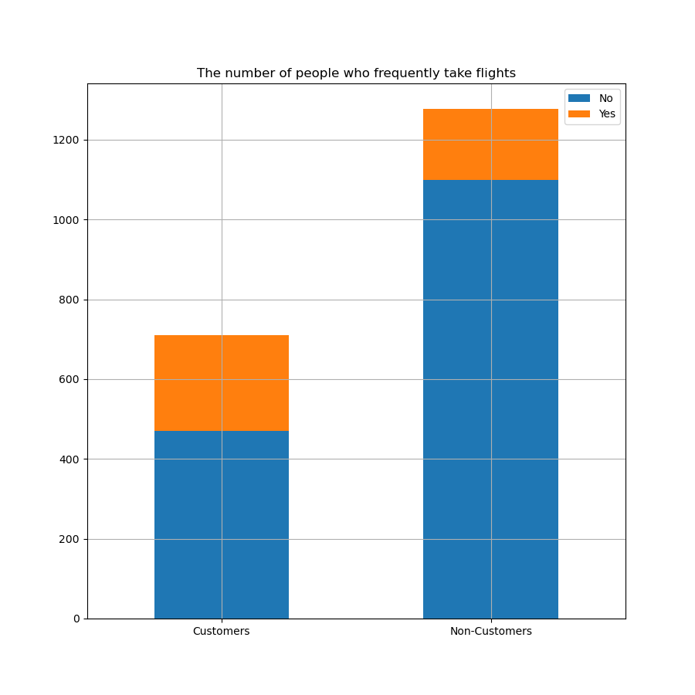
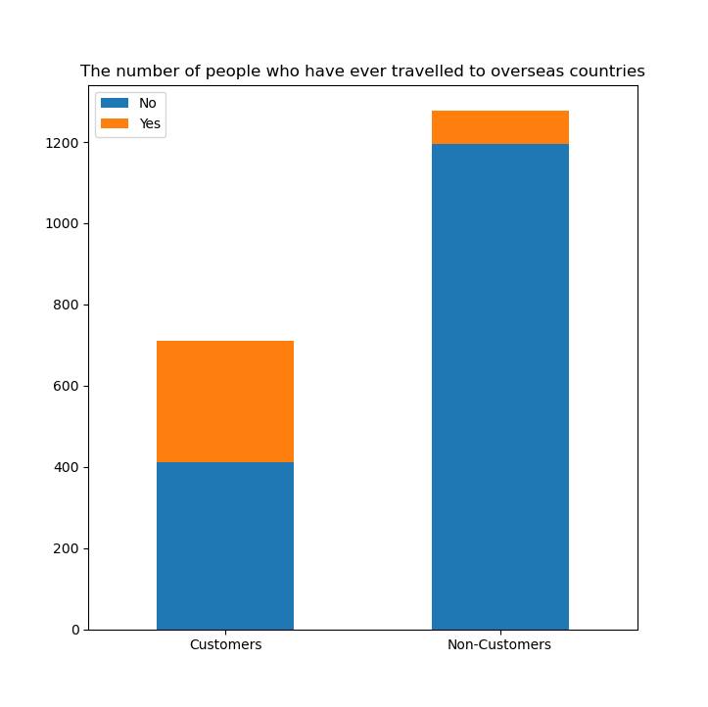
Travel Habits – Customers v Non-Customers
Travel habits of customers and non-customers were compared, in particular relating to frequency of flights and trips overseas.
Finding 1 – customers take more flights than non-customers (34% and 14%, respectively).
Finding 2 – the ratio of customers travelling overseas is higher than that of non-customers (42% and 6.4%, respectively).

Slide 4
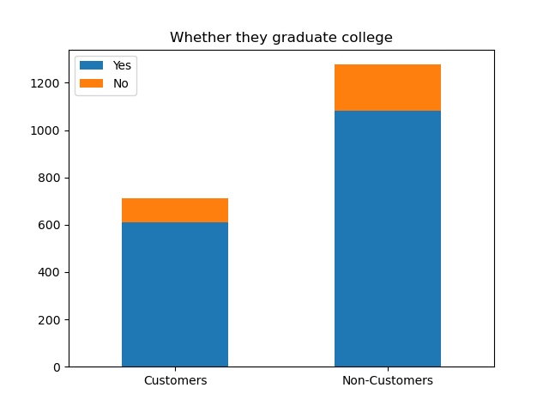
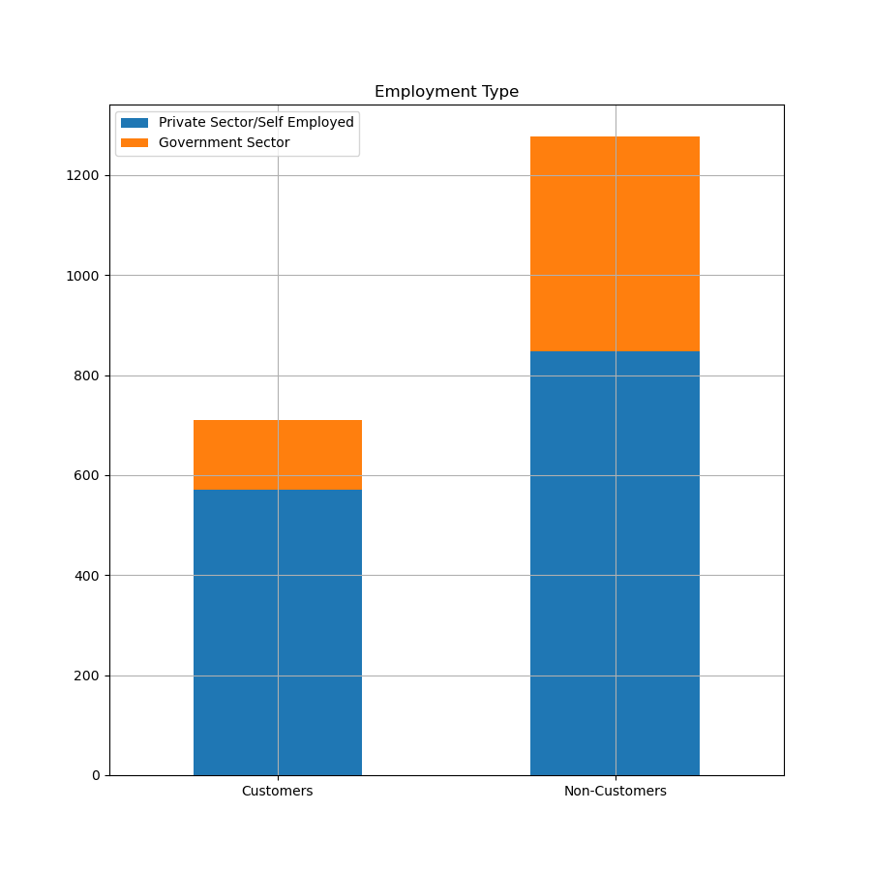
Profiles I – Education and Employment
As part of the Profiles analysis, the education and employment of customers and non-customers were compared.
Finding 1 – a higher percentage of customers graduated college than non-customers did (86% and 84%, respectively).
Finding 2 – a higher percentage of customers work for private companies or run their own business (80% and 66%, respectively).

Slide 5
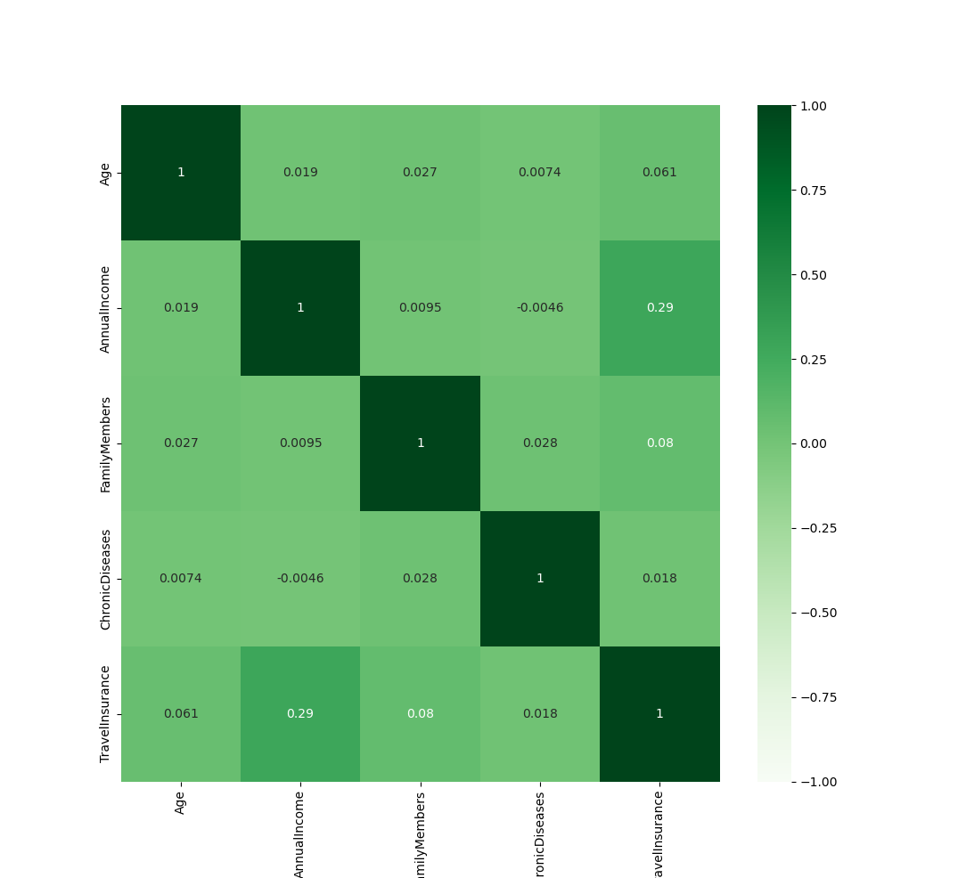
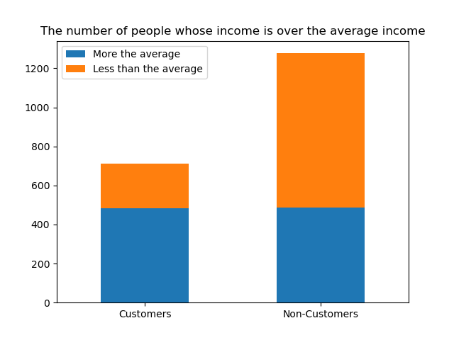
Profiles II – Income
As part of the Profiles analysis, the income of customers and non-customers was compared.
Finding 1 – the average income of all customers and non-customers is 932,763.
Finding 2 – the average income of customers is 1,133,239 (21.49% higher than the average of all customers and non-customers). There is a strong correlation between high income and being a customer.

Slide 6
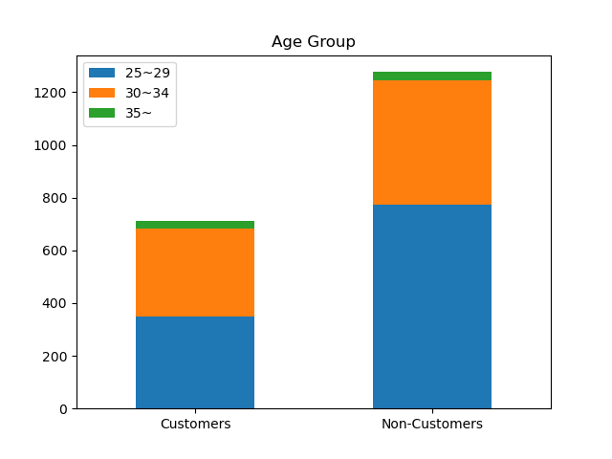
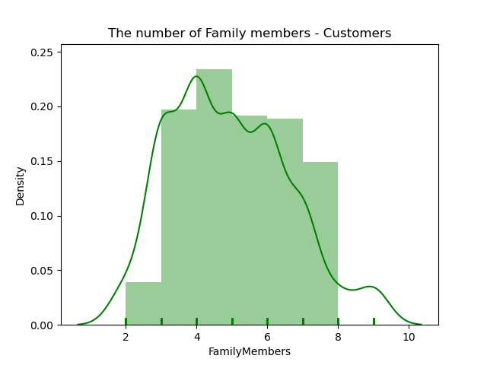
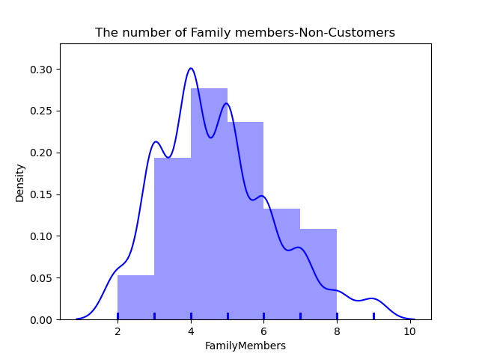
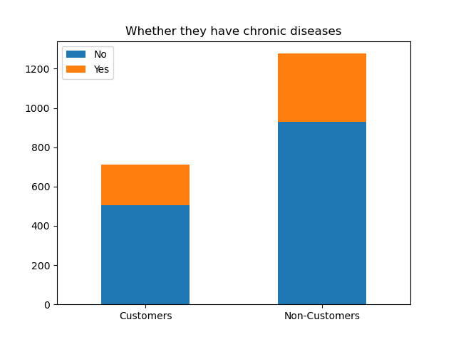
Profiles III – Age, Family Members, and Chronic Diseases
As part of the Profiles analysis, the age, number of family members, and chronic diseases of customers and non-customers were compared.
Finding 1 – there are no significant differences between the age profiles of customers and non-customers, the majority of whom tend to be between 20-30 years old.
Finding 2 – Most of the customers have 3~5 family members, however, most of non-customers’ family members number is 4~6.
Finding 3 – Both groups show meaningless results from having chronic diseases.

Slide 7
Conclusions
(1) Travel Habits
Customers travel more frequently than non-customers.
A greater proportion of customers have been overseas than non-customers.
(2) Profile - Customers
Customers tend to exhibit the following characteristics:
Take flights often.
Ever travelled to other countries.
Work for private companies or run own business and their annual incomes are higher than the average.
Their family members are made of 3~5 people.
(3) Profile – Non-Customers
Non-Customers tend to exhibit the following characteristics:
Less likely take flights.
Less likely ever travelled to other countries.
Work for government sectors and their annual incomes are less than the average.
Their family members are made of 4~6 people.
(4) Shared Characteristics
Based on our review, there are 152 non-customers who share common characteristic profiles with customers. This means they can be prospective customers.

Slide 8
Strategic Recommendations
Based on our review of the datasets, we recommend the following action points to the Company:
Marketing to Shared Profile Non-Customers
We have identified 152 non-customers who share similar characteristic profiles with customers.
The Company should consider targeted marketing strategies to these 152 non-customers. This will save costs by limiting budget spend, and target people (i) known to the Company who (ii) are most likely to become Customers.
Modify Marketing Materials
Customers tend to be successful, well-educated, and frequent travelers.
The Company should review its marketing materials and consider if it is targeting the typical customer profile (e.g. a new ad could feature wealthy business people travelling with their families).
Modify Marketing Media
The Company should also survey the media it uses for its marketing campaigns, and consider if such media are likely to reach out to likely customers (e.g. the Company could consider advertising in lifestyle magazines).
Further Analysis
The Company should consider additional data collection and analysis, in particular among customers (e.g looking at gender, place of residence, ownership of car, family make-up (e.g. if the customers have children or not).
Such information could help the Company improve its product by modifying it to appeal to the sophisticated Customer profiles created.

